Slide 2


Slide 3
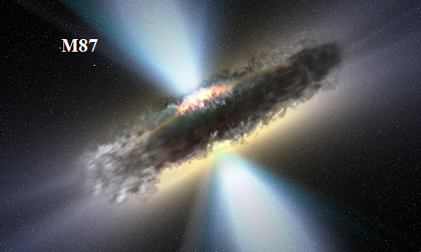
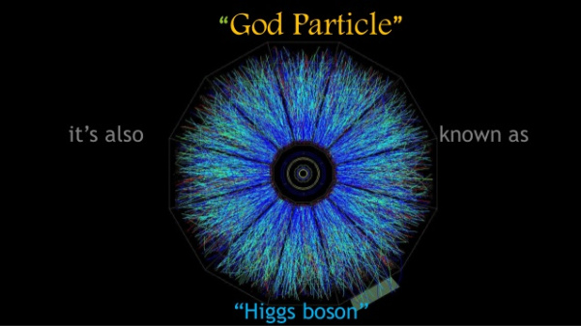
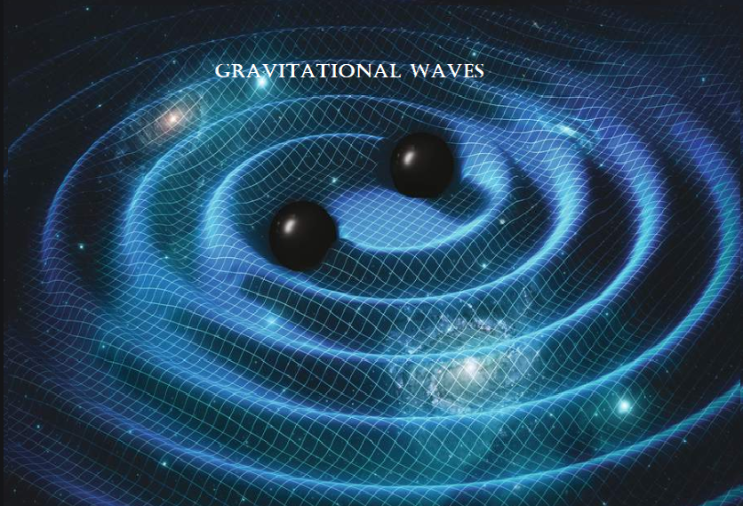

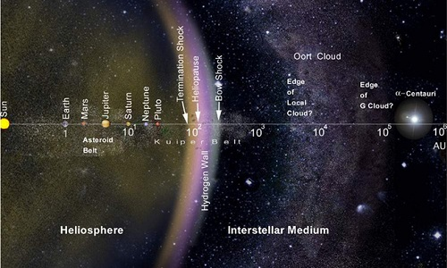
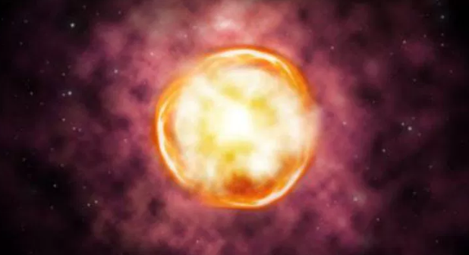
Supernova

Slide 4
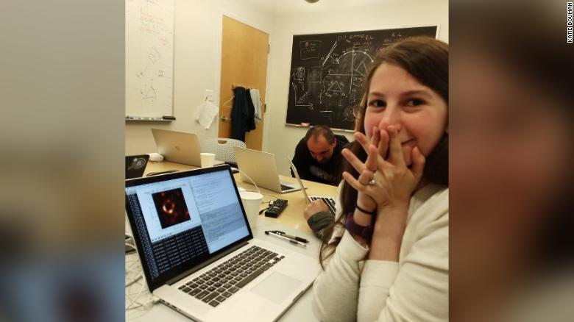

Slide 5
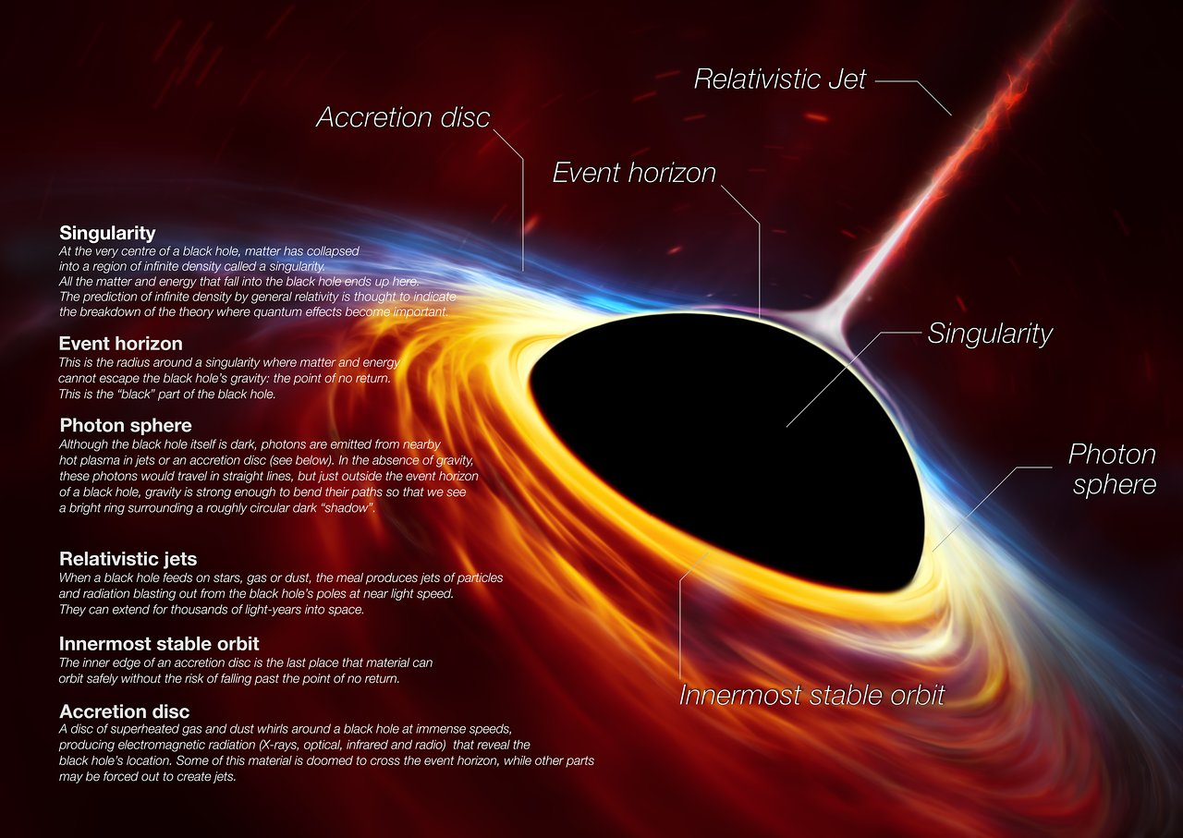

Slide 6


Slide 7
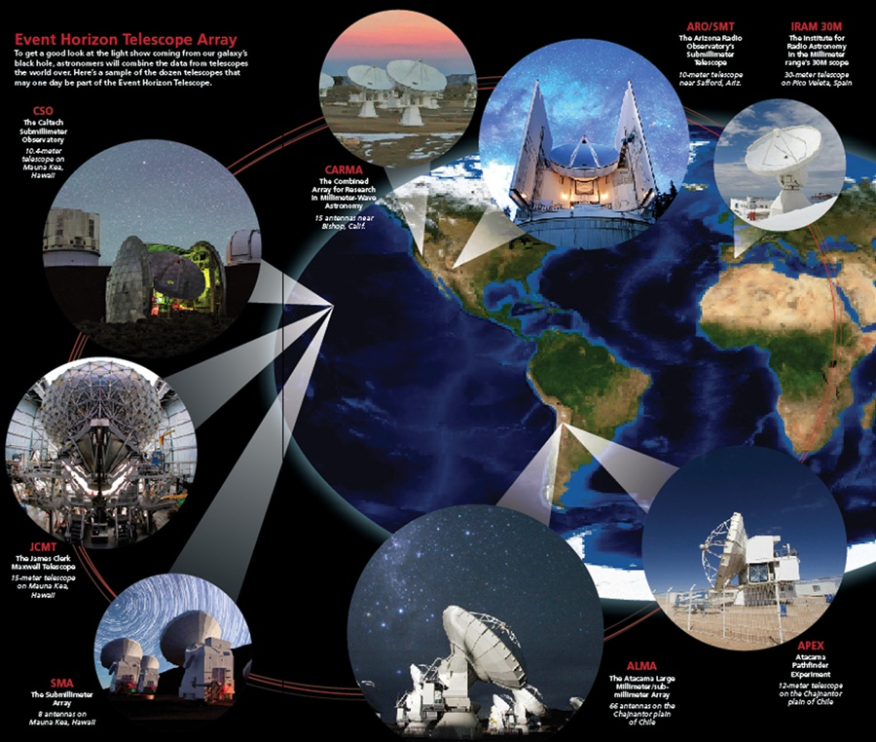

Slide 9


Slide 10
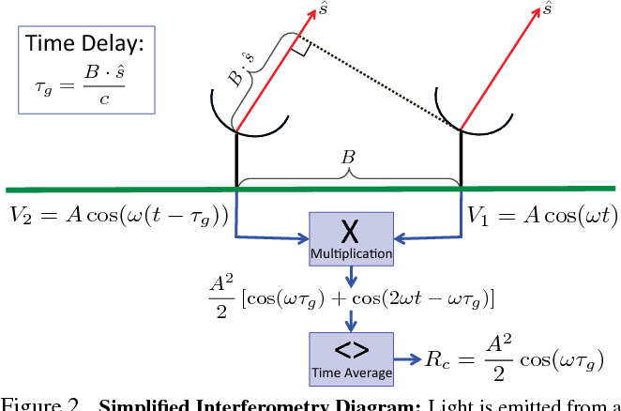

Slide 11
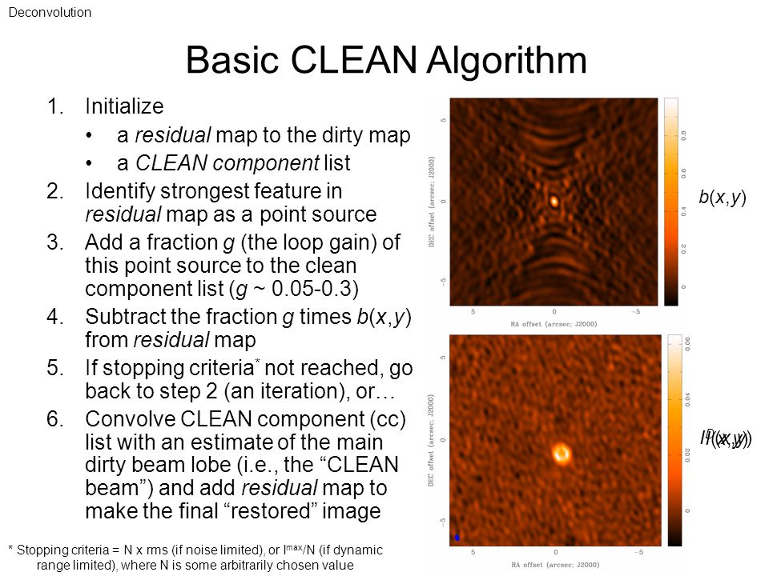

Slide 12
Key Points
It’s a shadow
M87’s black hole was predicted to be one of the largest viewable from Earth — making it a perfect target for the EHT
Each telescope of the EHT produced enormous amounts of data — roughly 350 terabytes per day
VLBI allows the EHT to achieve an angular resolution of 20 micro-arcseconds — enough to read a newspaper in New York from a sidewalk café in Paris

Slide 13
How does a star become a black hole, or part of a supermassive black hole? A star burns energy in the form of nuclear fuel. This energy pushes outward and balances the inward pull of gravity created by the mass of the star. When a star runs out of fuel, it can no longer generate any push against the gravity of all its mass. The gravity forces everything toward the center of the burned out star and the core collapses into a black hole. The outer layers of the star explode in what is called a supernova.

Slide 14
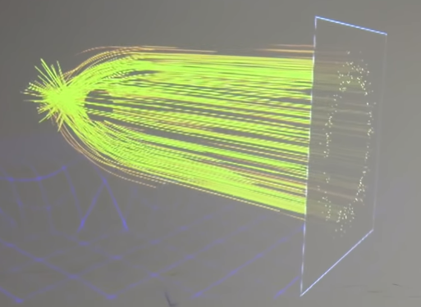

Slide 15
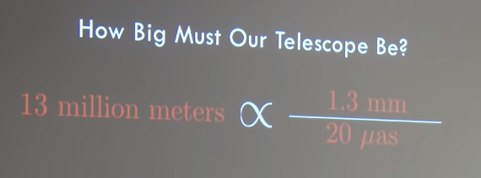
Wavelength
Telescope Size
Angular Resolution

Slide 22
